Slide 1
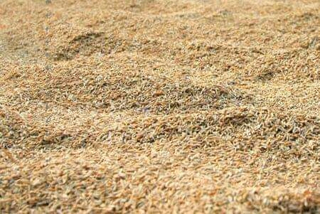
NAZIFI AND BALARABE TRADING ENTERPRISE
Rice Farming and Rice Processing
No.817 Hausawa Quarter.
Phone number: +2348026402617
Email address: nazifibalarabe@yahoo.com

Slide 2
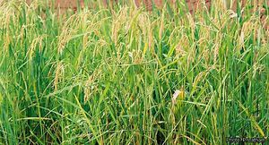
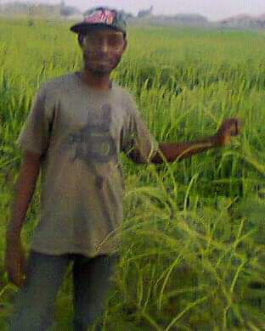
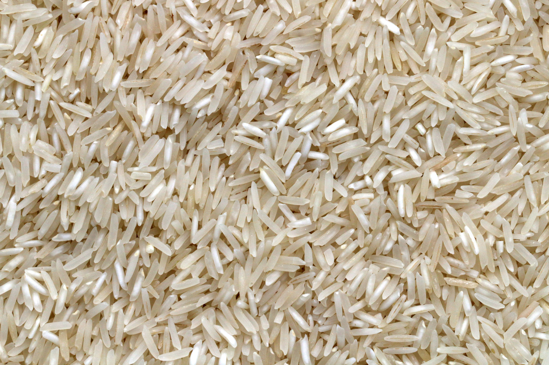
Rice Farming and Rice Processing
Start up Business Project.

Slide 3
Introduction
Nazifi and Balarabe Trading Enterprise is a partnership business based on farming and rice Processing, our aims is to rise the capacity of rice Processing and rice farming to burst the economy and provisioning of job opportunities and eliminating of hunger in Northern Nigeria.The business is founded by Nazifi Balarabe Musa and Balarabe Muhammad Kofar Naisa as the board directors which has the duration of less than four years of invention.The principal address for the business is No 817 Hausawa Galadanchi, Gwale Local Government and has the cultivation premises area in yadakwari Garun Malam local government.

Slide 4
Business Category
As a start up business, the business is been categorize into buying a raw rice from farmers and process it for milling station into finished rice and sold it to the retailers and some wholesalers, the business is initiated by Nazifi Balarabe and the help of Balarabe Muhammad Kofar Naisa in the year 2017.The business is a partnership with capital and Assets worth less than one million naira, but we are applying for the loan amounted to three million from CBN AGMEIS program through Nirsal Micro Finance Bank.The business is not registered with CAC but we're in the process.

Slide 5
The Problem
As per as business is a scale up, and as our problem concerning rice is not what or who to produce for, but is the shortage of rice as by the current policy to banned the importation of foreign rice by Federal republic of Nigeria which coursed the shortage of rice and the Domestic rice price to raise up two times compared to last two years back price, and the local rice have no qualities like the foreign one, peoples were suffered because the local rice is not purifier and also its price is rapidly rise up especially in the rainy season.

Slide 6
The Solutions
The solutions to the above issue is, as like our enterprise embarked into the investment of rice processing and we are able to provide a quality perboiled rice in the cheaper price and also to burst the nation's economy, there by providing jobs opportunities and eliminating hunger by the core SDG'S agenda.We are now preparation for the bringing the milling machine through the loan amount we are seeking from Federal Govt.

Slide 7
What make my Solution Unique
What makes my solutions unique to the problem is that, since our local rice producers used local or traditional ways in milling their products, we will assist them to Mill their rice in the modern way and in a cheaper price for them and it will help them to reduce patique.We have been trained on how to operate the machine through AGMEIS program By CBN.

Slide 8
The specific problem my business is Addressing
The specific problem that we are facing is lack of capital and funds, but through funding organizations to Young Enterprenuers like yours, financial institutions whose provide the loan with low interest we would overcome the problems.

Slide 9
How do I marketing our products
We advertised on social media handle like WhatsApp and Facebook, we marketing the rice by our marketing team to the suppliers, retailers and consumers.We advertised in market and in the community.

Slide 10
Conclusion
The business is going well even we are facing so much challenge for competitors and Cash flows.
But we doing our best to get all these challenge by introducing new innovation and growth base on Sustainable development goals agenda.
We are working on SDG'S agenda number one and the number two.

